Slide 1
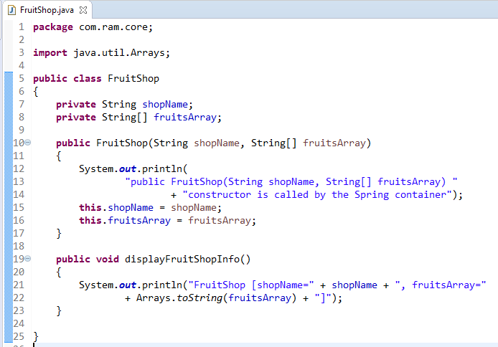
Constructor Dependency Injection with Array of String

Slide 2
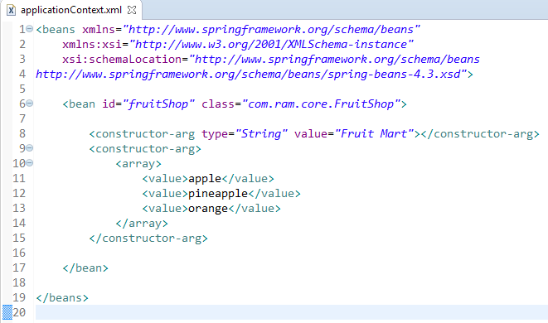
Constructor Dependency Injection with Array of String
We are providing the information into the bean by applicationContext.xml file.
The constructor-arg element invokes the constructor. In this example FruitShop(String shopName, String[] fruitsArray) constructor will be invoked.
The array element of constructor-arg is used here to define the array.

Slide 3
Constructor Dependency Injection with Array of String
FruitShop
What object to instantiate?
What object to configure and how to configure?
The Spring Container
(ApplicationContext)
applicationContext.xml
FruitShop
Object
FruitShop
[shopName=Fruit Mart,
fruitsArray=[apple, pineapple, orange]]
Create the FruitShop object.
Configure the FruitShop object.
Manage FruitShop object complete life cycle from creation till destruction.

Slide 4
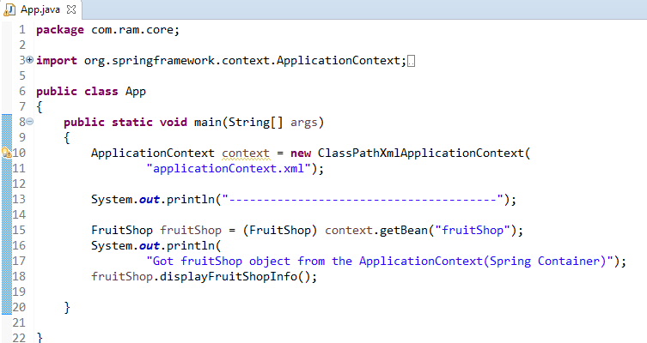
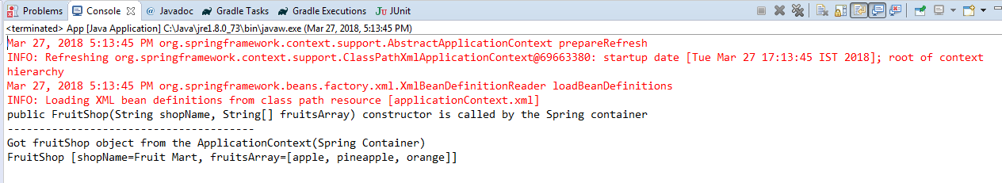
Constructor Dependency Injection with Array of String

